Slide 1
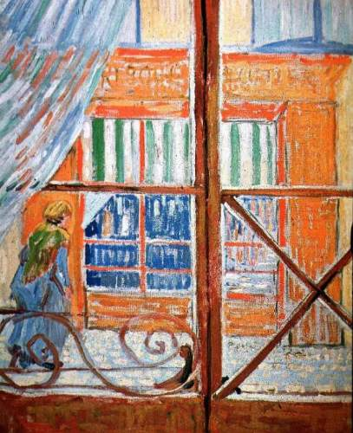
More Induction
A Pork-Butchers Shop Seen from a Window
Van Gogh
Discrete Structures (CS 173)
Madhusudan Parthasarathy, University of Illinois

Slide 2
Midterm grades
$Done:Moodle$
Freshmen: formal roster
People did very well, in general.
Thanks to TAs; very lenient grading
Estimated grade thus far
A+,A, A-: 90 or above;
B+, B, B-: 80 or above;
C+, C, C-: 70 or above
D ,F : you need to be worried; come talk to us

Slide 3
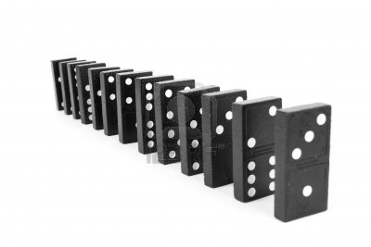
Does domino n fall?

Slide 4
Does domino n fall?
Suppose domino k falls. Then domino k+1 falls.
$$fall\left(k\right)→fall(k+1)$$

Slide 5
Does domino n fall?
Suppose domino k falls. Then domino k+1 falls.
$$fall\left(k\right)→fall(k+1)$$
The first domino falls
$$fall\left(1\right)=T$$

Slide 6
Induction
Inductive hypothesis: Suppose domino k falls.
Inductive conclusion: Domino k+1 falls.
Base case: The first domino falls.

Slide 7
Basic structure of induction proof
Claim: $P\left(n\right) for all n=0, 1, 2, 3…$
Base: $P(0)$ is true.
Inductive step: $P\left(k\right)→P(k+1)$
or $P\left(0\right), P\left(1\right), …P\left(k\right)→P(k+1)$
Weak Induction
Inductive hypothesis
Inductive conclusion
Strong Induction

Slide 8
Today’s lecture
Induction template
More examples of induction proofs
Graph coloring
Multiple base cases
Another strong induction
Prime factorization
Towns connected by one-way streets

Slide 9
Induction template

Slide 10
Graph coloring
Claim: For any positive integer $D$, if all nodes in a graph have degree $≤D$, then $G$ can be colored with $D+1$ colors.

Slide 11
Graph coloring
Claim: For any positive integer $D$, if all nodes in a graph have degree $≤D$, then $G$ can be colored with $D+1$ colors.
P(n): Any graph G with n nodes where all nodes have degree $≤D$ $can be colored with$D+1 colors
Structure of proof:
Notes:
Base case: A graph that has 1 node has maximum degree less than or equal to 0 and can be colored with 1 color.
Induction: Suppose that any graph with at most $k−1$ nodes with maximum degree $≤D$ can be colored with $D+1$ colors. We need to show that any graph of $k$ nodes with maximum degree $≤D$ can also be colored with $D+1$ colors.
Let $G$ be a graph with $k$ nodes and degree $≤D$. Remove one node $v$ and its edges from the graph to form a subgraph $G′$ with $k−1$ nodes and at most degree $D$ (since removing edges can’t increase the degree). By the inductive hypothesis $G′$ can be colored with $D+1$ colors. Node $v$ is connected to at most $D$ other nodes, so it can be assigned the remaining $(D+1)$th color.
QED

Slide 12
Graph coloring
Notes:
Base case: A graph that has 1 node has maximum degree less than or equal to 0 and can be colored with 1 color.
Induction: Suppose that any graph with at most $k−1$ nodes with maximum degree $≤D$ can be colored with $D+1$ colors. We need to show that any graph of $k$ nodes with maximum degree $≤D$ can also be colored with $D+1$ colors.
Let $G$ be a graph with $k$ nodes and degree $≤D$. Remove one node $v$ and its edges from the graph to form a subgraph $G′$ with $k−1$ nodes and at most degree $D$ (since removing edges can’t increase the degree). By the inductive hypothesis $G′$ can be colored with $D+1$ colors. Node $v$ is connected to at most $D$ other nodes, so it can be assigned the remaining $(D+1)$th color.
QED

Slide 13
Greedy graph coloring algorithm

Slide 14
Postage example (with strong induction)
Claim: Every amount of postage that is at least 12 cents can be made from 4- and 5-cent stamps.

Slide 15
Postage example (with strong induction)
Claim: Every amount of postage that is at least 12 cents can be made from 4- and 5-cent stamps.
Notes:
I.e., show that $n=4a+5b$ for some natural numbers $a$ and $b$ and any integers $n≥12$.
Base cases:
$n=12$: $a=3, b=0⇒4∗3+5∗0=12$
$n=13$: $a=2, b=1⇒4∗2+5∗1=13$
$n=14$: $a=1, b=2⇒4∗1+5∗2=14$
$n=15$: $a=0, b=3⇒4∗0+5∗3=15$
Induction: Suppose that there exist natural integers $a$ and $b$ such that $n=4a+5b$ for each integer $n∈\{12, 13, …k−1\}$, where $k≥1$6. Then, we have to show that $k=4i+5j$ for some natural$i$ and $j$. Since $k≥1$6, $k−4≥12$, so $k−4=4a+5b$ for some natural $a,b$. So $k=4\left(a+1\right)+5b$.
QED

Slide 16
Nim
Nim: Two piles, two piles of matches. Each player takes turns removing any number of matches from either pile. Player that takes last match wins.
Claim: If the two piles contain the same number of matches at the start of the game, then the second player can always win.

Slide 17
Prime factorization
Claim: Every positive integer can be written as the product of primes.

Slide 18
Program verification

Slide 19
Puzzle

Slide 20
Tips for induction
Induction always involves proving a claim for a set of integers (e.g., number of nodes in a graph)
Sketch out a few simple cases to help determine the base case and strategy for induction
How many base cases are needed?
How does the next case follow from the base cases?
Carefully write the full inductive hypothesis and what you need to show
Make sure that your induction step uses the inductive hypothesis to reach the conclusion

Slide 21
Next class
Recursive definitions

